Slide 1
Optimizing Material Strength Predictions in Complex Lattice Topologies Using Graph Neural Networks (GNNs)
June 2nd 2026
Alexander Adamsª and Dr. Xing Liu^{b}
ª Department of Mechanical Engineering and Materials Science, University of Pittsburgh, Pittsburgh, PA 15260
^{b} Department of Mechanical and Industrial Engineering, New Jersey Institute of Technology, Newark, NJ 07102

Slide 2
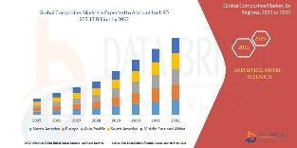
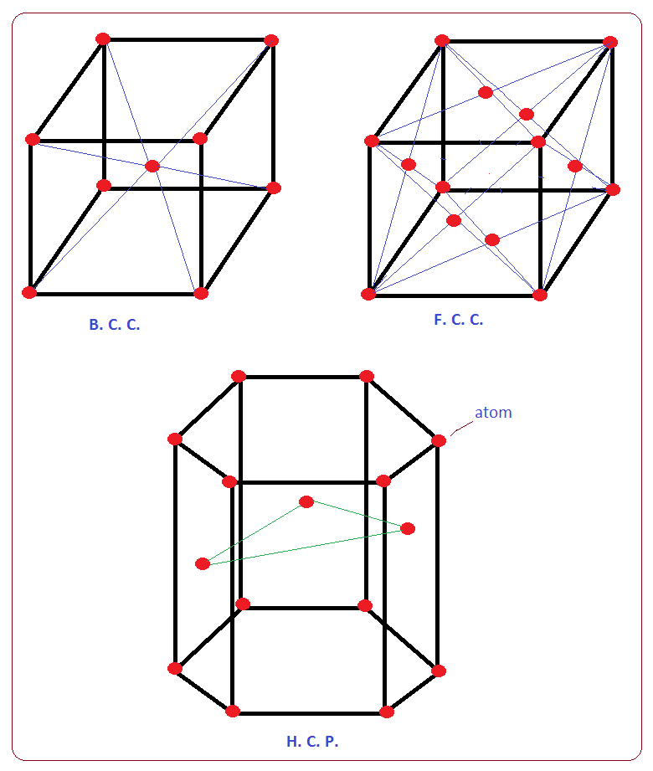
Background
$280B+
The global composites market was valued at approximately $110–133 billion in 2024, with projections to reach $205-313 billion by 2032–2034 (CAGR ~8–9%)
30-50%
Advanced Materials Global Market (2024)
Weight reduction possible with lattices
40%+
Stiffness-to-weight improvement over foams
Critical industries relying on advanced architecture materials:
▸ Aerospace & Defense
▸ Biomedical Implants
▸ Automotive Lightweighting
▸ Energy Absorption
The Core Problem
Theory:
Lattices assumed to be perfectly periodic:
uniform strut dimensions, no defects,
identical unit cells throughout
Reality:
Manufacturing introduces defects: strut diameter variation, node misalignment, missing struts, surface roughness → Theoretical models fail to predict actual strength and fracture behavior → Shaikeea et al. (2022): K_{Ic} alone is INSUFFICIENT to characterize
fracture in 3D metamaterials

Slide 3
Literature Review
Micropolar effects on elastic properties and fracture toughness of planar lattices
Berkache, Phani & Ganghoffer, Eur. J. Mech. A (2022)
Discrete asymptotic homogenization → explicit micropolar constitutive relations vs. relative density ρ̄
Hexagonal lattice internal length lᶜ ∝ ρ̄^0.5, bending-dominated architectures need micropolar enrichment
Resolves discrepancies between Chen et al. 1998 gradient theory and experimental data
Limitation: Assumes perfect periodicity. Breaks down at higher relative densities and cannot handle defects.
The toughness of mechanical metamaterials
Shaikeea, Cui, O'Masta, Zheng & Deshpande, Nat. Mater. (2022)
Limitation: Cannot be applied off-the-shelf to discrete architected materials.
Manufactured ~10M-cell octet-truss specimens via large-area projection microstereolithography
Kᴵᴶ depends on both a/ℓ and load triaxiality λ, KI alone is insufficient; T-stress governs failure
Fracture mechanism map (ρ̄/εᴼ vs. T̄) fully characterizes failure, plane-stress < plane-strain toughness (reversed!)
Micro-architectured materials: past, present and future
Fleck, Deshpande & Ashby, Proc. R. Soc. A (2010)
Establishes nodal connectivity Z as the key parameter: stretching-dominated (Z≥4) vs. bending-dominated (Z=3)
Fracture toughness Kᴵᴶ ∝ ρ̄ᵈ with d=2 (hexagonal), d=1 (triangular), d=0.5 (Kagome)
Kagome achieves density-independent toughness Gᴵᴶ, foundation for my topology exploration
Limitation: Computationally expensive with billions of DOF per simulation. Not scalable to defect-space exploration.
Notes:
Berkache et al. (2022) used micropolar continuum theory to derive analytical scaling laws for hexagonal, triangular, and kagome lattices. Shaikeea et al. (2022): fracture in 3D octet-truss metamaterials depends on T-stress AND Kᴵ, not Kᴵ alone. Standard testing protocols developed for continua are fundamentally inadequate.
Fleck, Deshpande & Ashby (2010) show fracture toughness Kᴵᴶ ∝ ρ̄ᵈ via full lattice simulations.

Slide 4
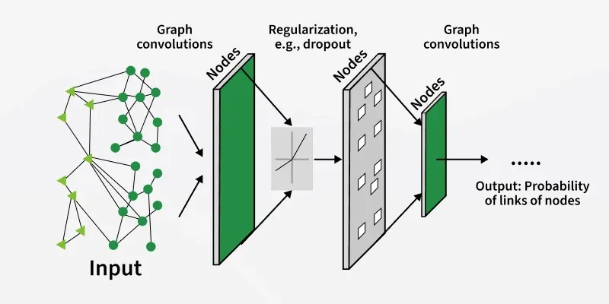
Research Workflow
Lattice
Geometry
Tabular Features
GNN Model
→
→
→
Predicted
Strength
Node positions,
connectivity,
boundary conds.
Lattice geometry encoded into table for additional model training input
Graph-structured
forward pass;
learns stress fields
Why Graph Neural Networks?
Lattice = graph: nodes are joints, edges are struts, GNNs operate natively on this representation
Inference is orders of magnitude faster than FE simulation (no billions of DOF solve)
Handles irregular, defective geometries that break analytical homogenization assumptions
Can encode graph topology as node/edge/global attributes

Slide 5
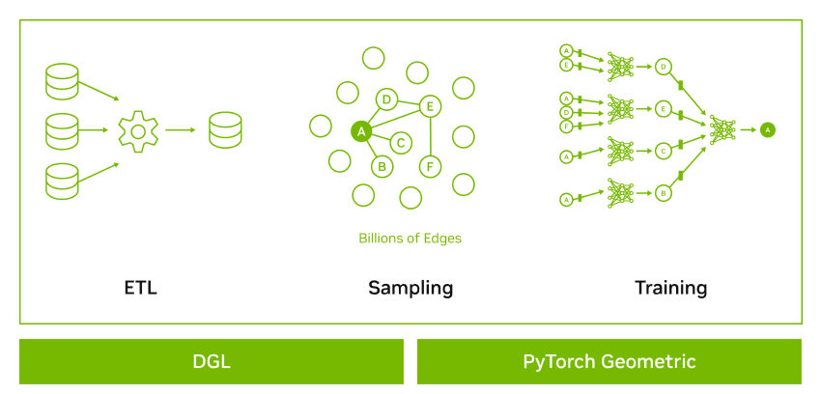
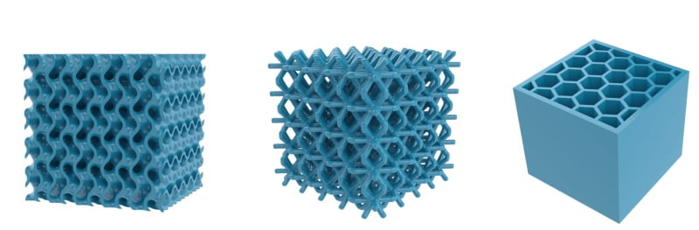
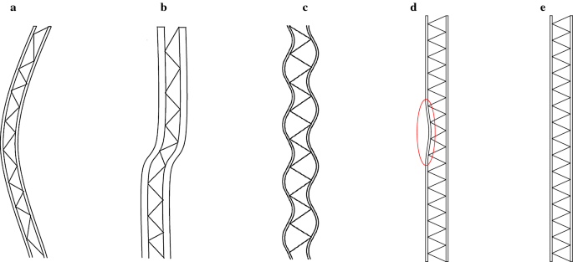
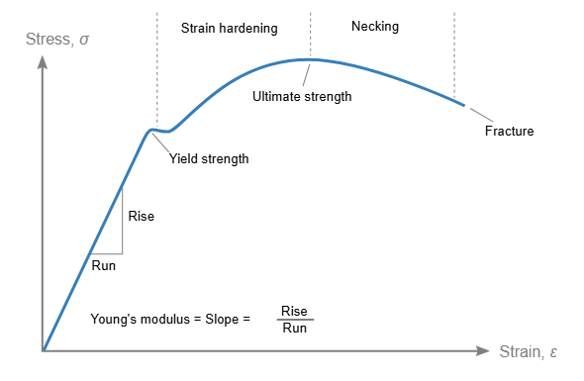
Research Goals
1. Build The Graph Dataset
2. Train & Validate GNN
Generate diverse lattice geometries (hexagonal, kagome, triangular, octet-truss) with controlled randomness & defects. Run FE simulations to produce labeled strength outputs
Train on graphical lattice representations + tabular features. Validate Kᴵᴶ predictions against FE ground truth and Fleck/Berkache scaling laws
3. Fracture Mechanism Prediction
4. Expected Outcome
Extend model to predict failure mode (tensile fracture vs. elastic buckling) and the T-stress contribution, going beyond Kᴵᴶ-only characterization.
A fast and defect-aware model for lattice strength, enabling rapid design iterations without full FE solves. Potential to generalize across topologies.

